Slide 1
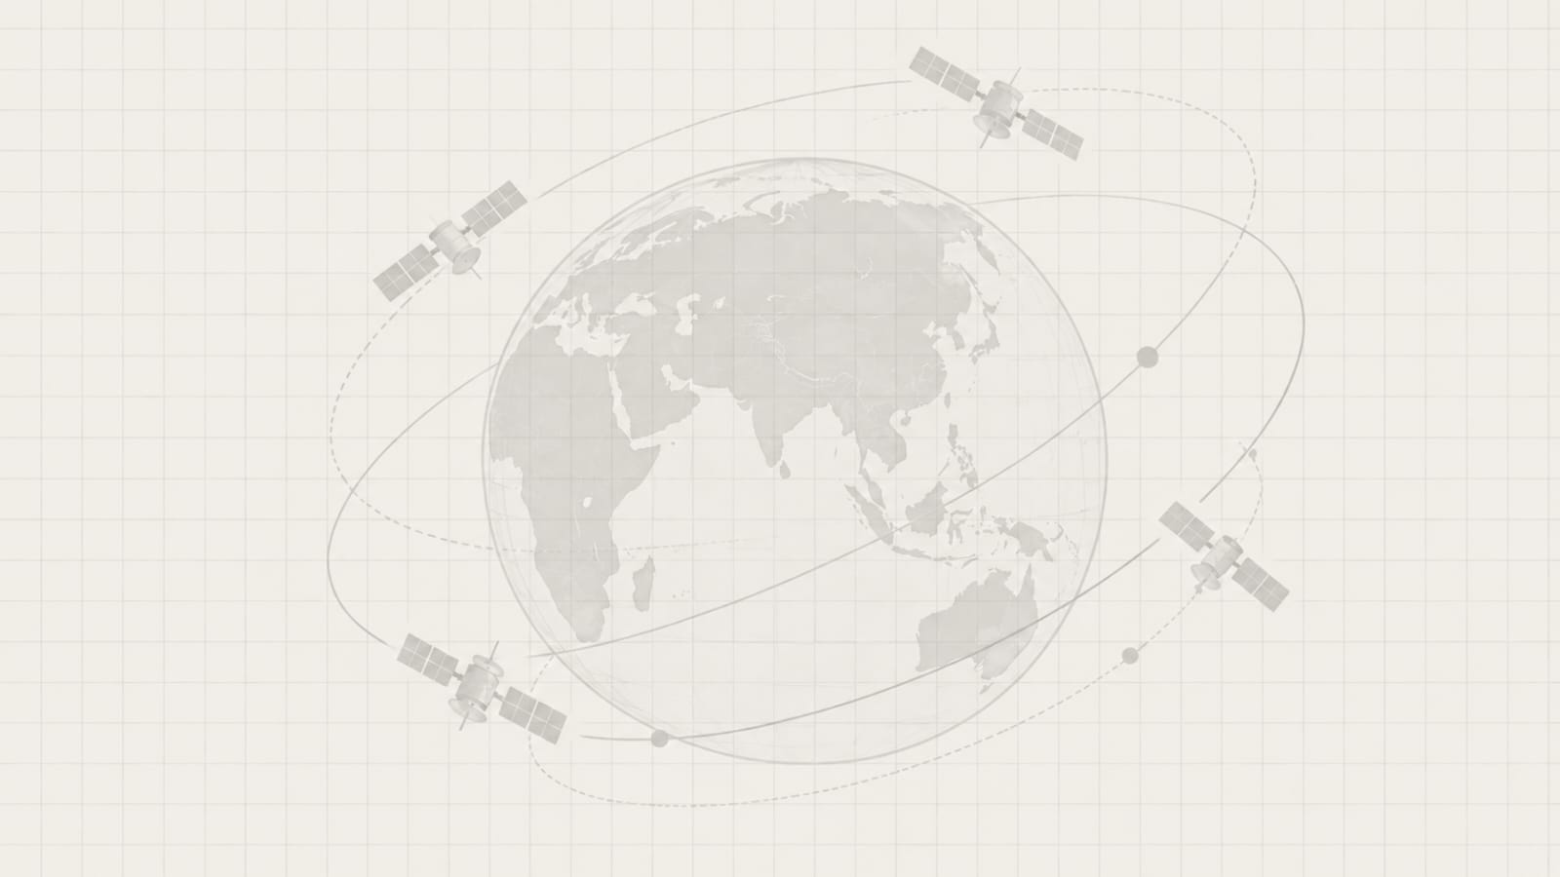
CANOPUS - Change Analysis & Neural Observation of Persistent Unified Scenes

Slide 2
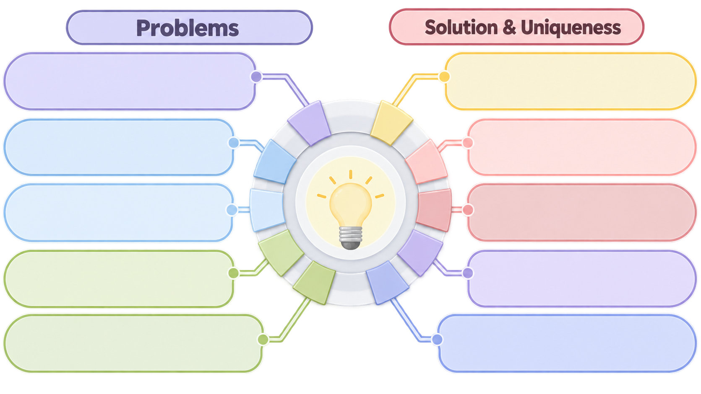
Satellite archives are now multi-temporal, multi-spectral, and multi-sensor. The raw volume of data is no longer the bottleneck - making sense of it is.
The Data Explosion
Semantic & Multimodal Retrieval
Combines text and satellite imagery via Encoder Based Architecture in a shared 512-D space for semantic retrieval. Odrant + PostGIS filter scenes by location, time, sensor, and quality.
1.
1.
Existing catalogues require prior knowledge of location, date, satellite/sensor, and product type, leaving relevant data undiscovered without knowing where or when to search.
Two-Tier False-Alarm Suppression
Metadata-Only Search
ML cloud masking, shadow ray tracing, and radiometric calibration clean imagery at ingestion. Sub-pixel alignment and Left-MAD seasonal checks reduce false alarms during analysis.
2.
2.
Meaning is Missing
Multi-Temporal Change Analysis
Analysts need intent-based search, such as "new structures near a river" or "vehicle concentrations on open ground." Traditional metadata search cannot understand such semantic queries.
3.
3.
A spatio-temporal foundation model detects when changes emerge across multi-year imagery. Feature differences locate changes, while spectral indices and vision models classify what changed.
4.
4.
Multi-Temporal Complexity & False Alarms
Unsupervised Clustering &
Cross-Site Discovery HDBSCAN
Naive T1-T2 comparison creates false alarms from clouds, shadows, haze, seasonal and imaging variations, making it difficult to separate real change from noise or determine when it emerged.
5.
5.
Automatically clusters similar satellite scenes into distinct groups. Analysts can select any scene to instantly retrieve matching locations using vector similarity.
Analyst Decision & Provenance Gap
Analyst Triage, Reranking & Provenance
Detected changes are difficult to prioritize and verify, while analyst decisions lack effective feedback and traceable provenance for reporting and audit.
Rank: Confidence alerts with before/after evidence.
Verify & Learn: Confirm/Reject refines retrieval via Rocchio re-ranking.
Audit & Export: Immutable logs in GeoJSON, PDF & CSV

Slide 3
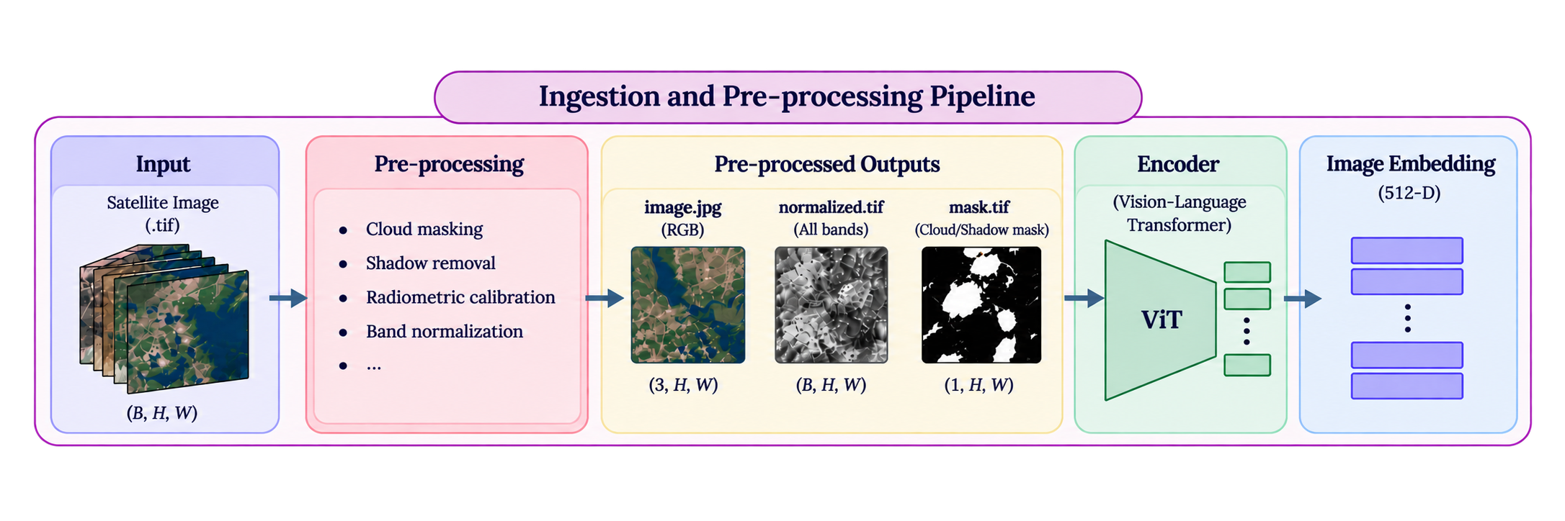
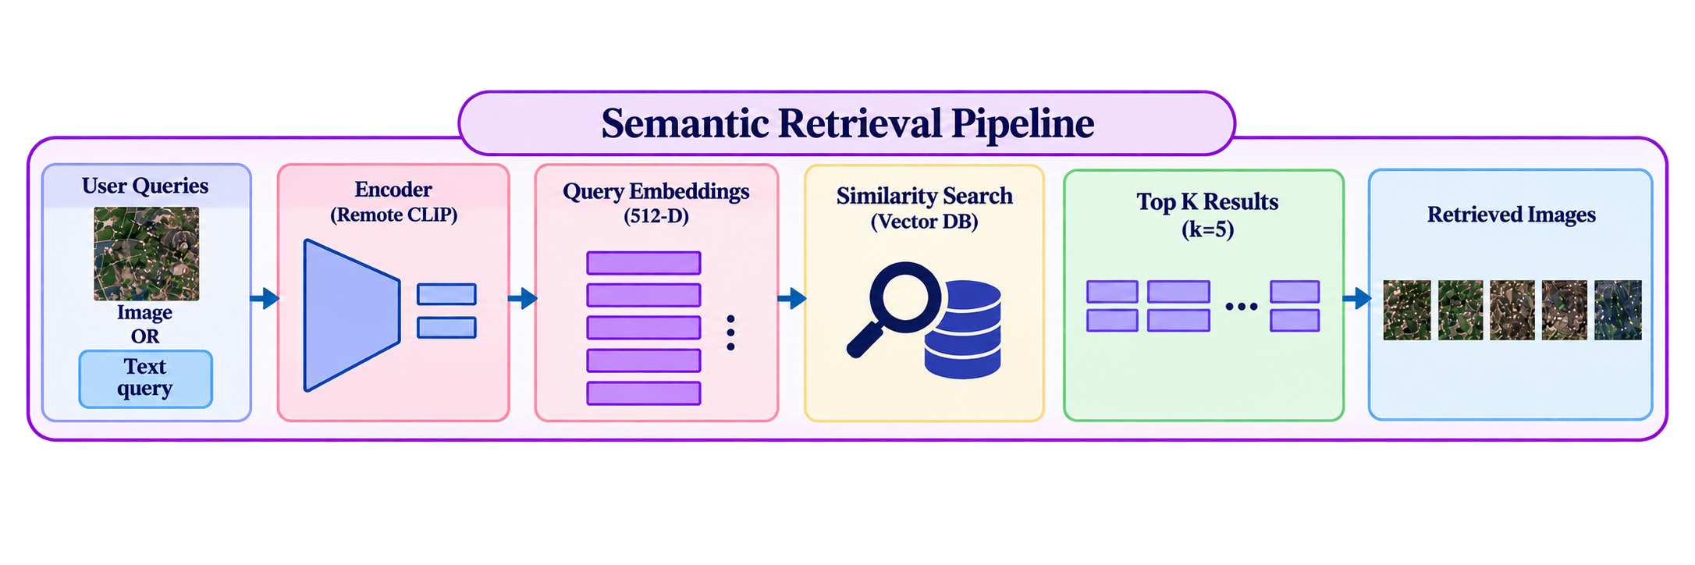
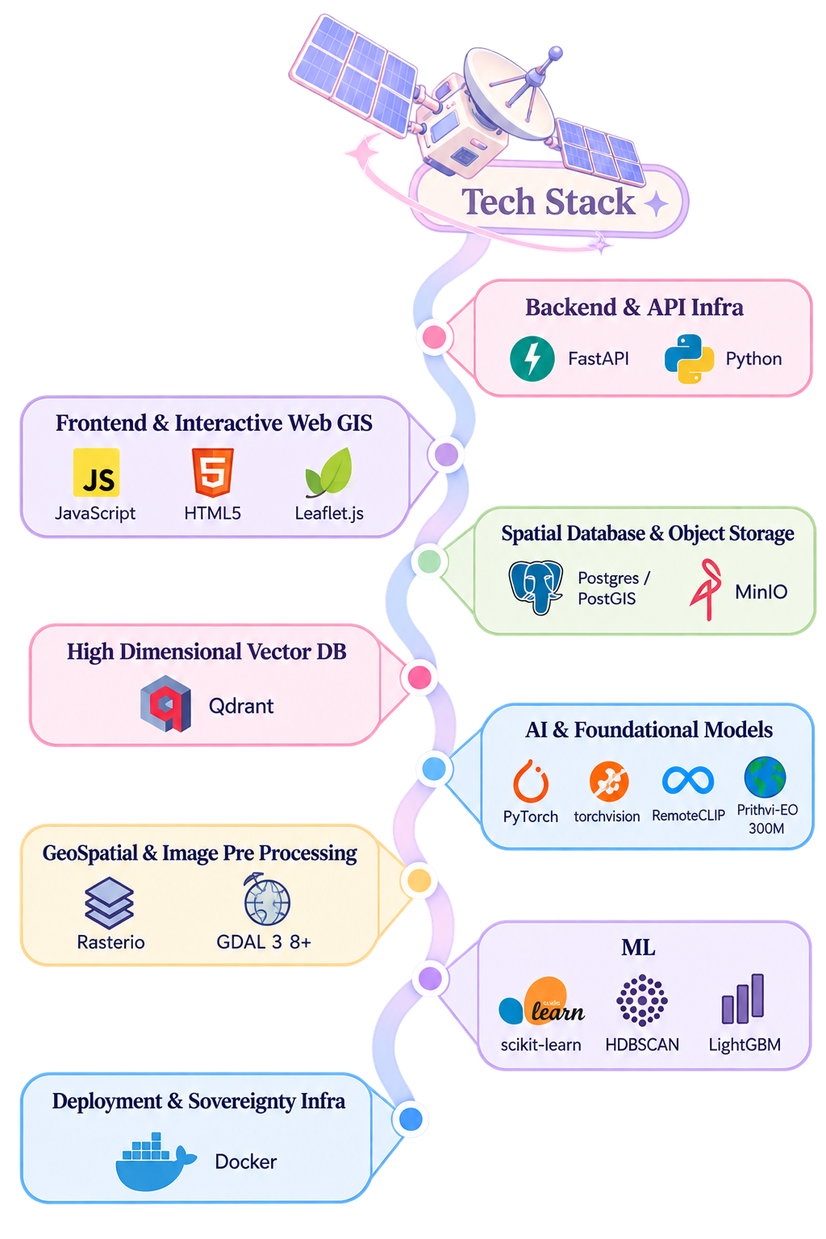


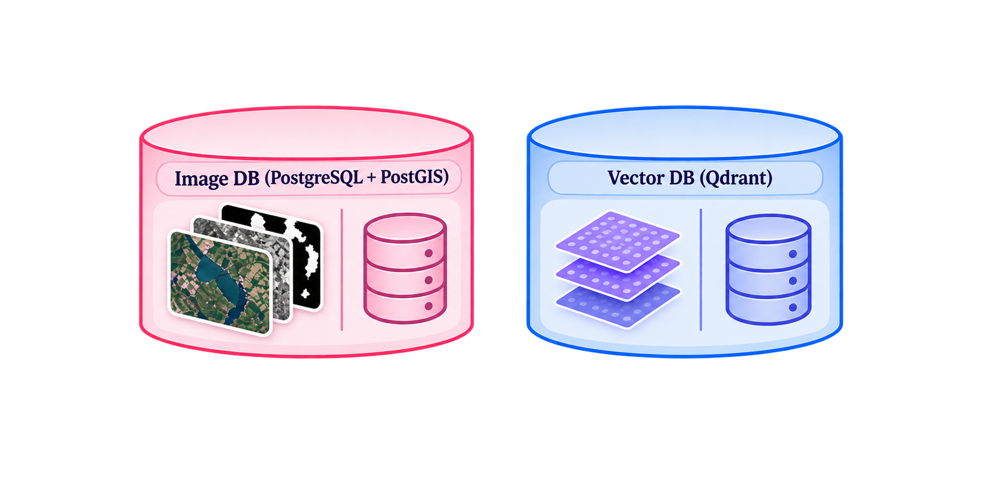

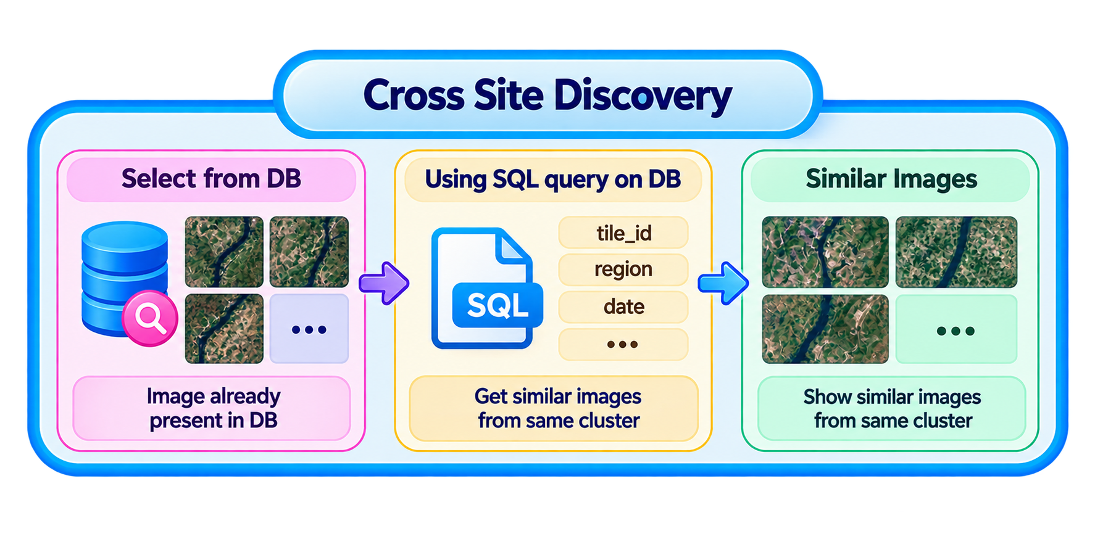
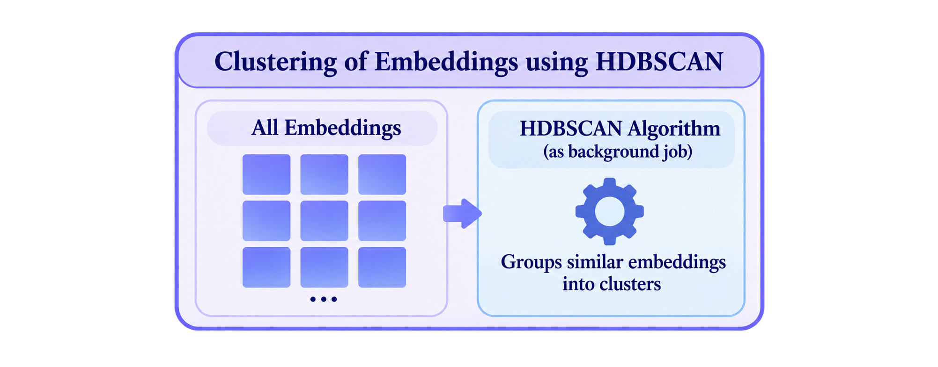



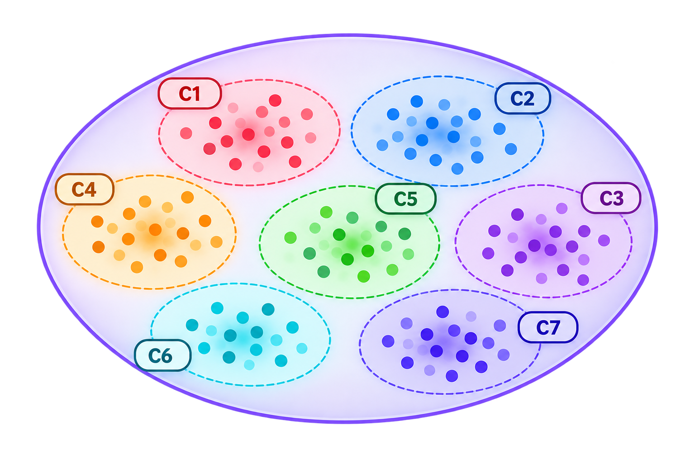
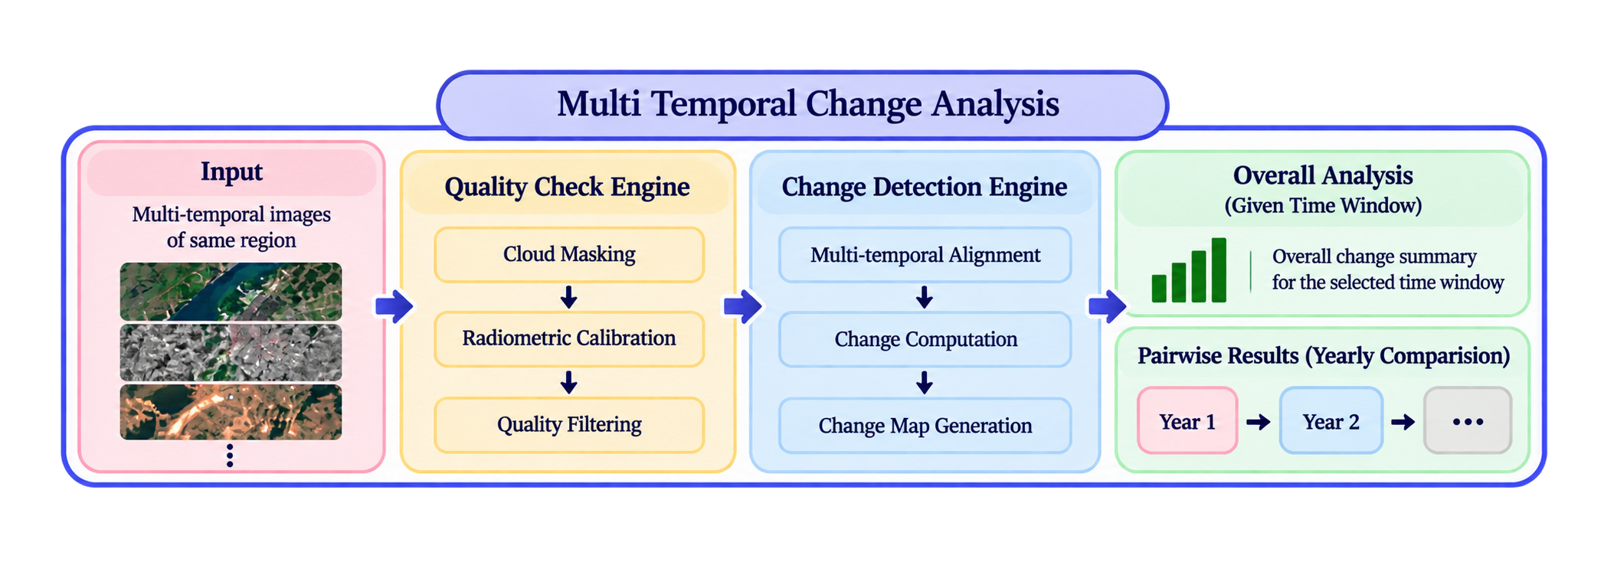
System Architecture & Tech Stack

Slide 4
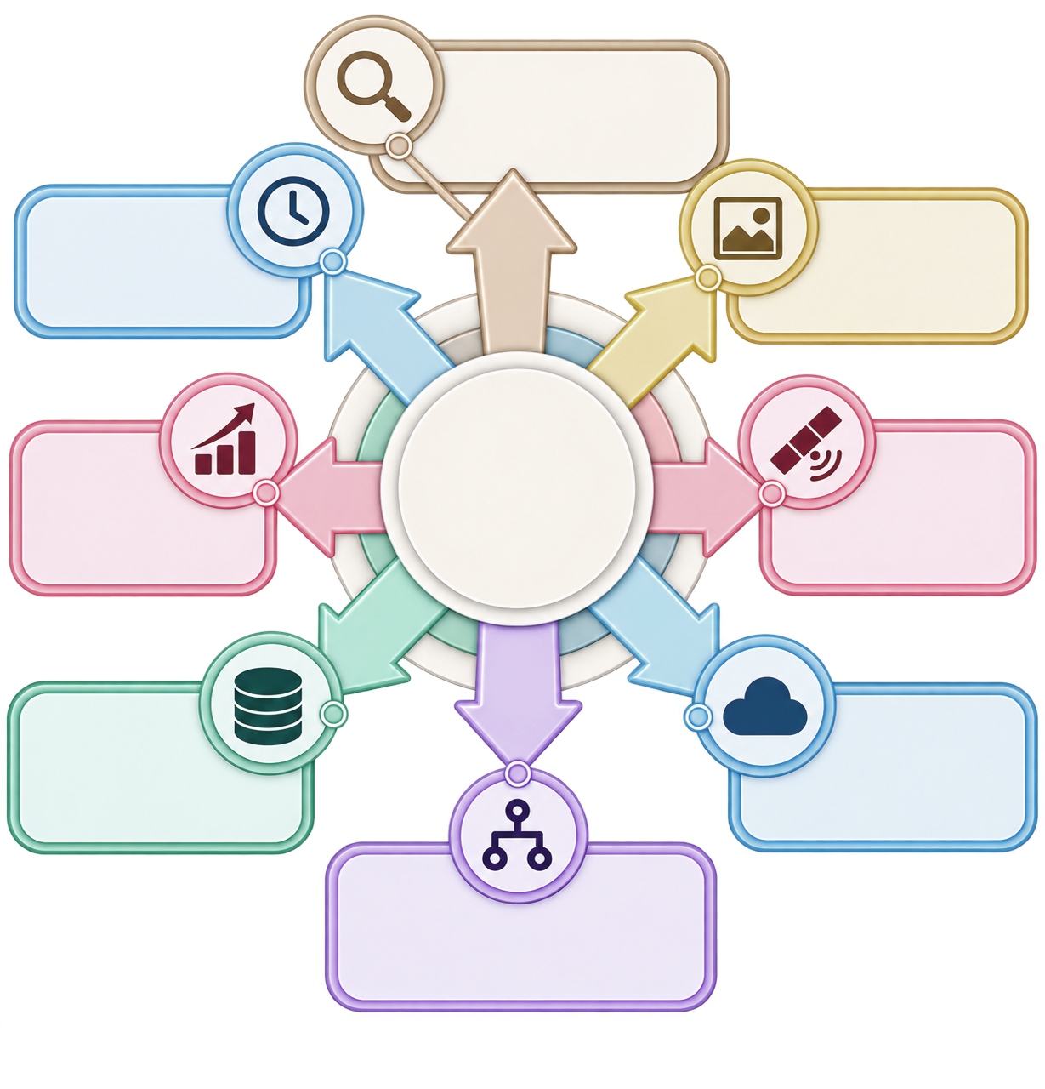
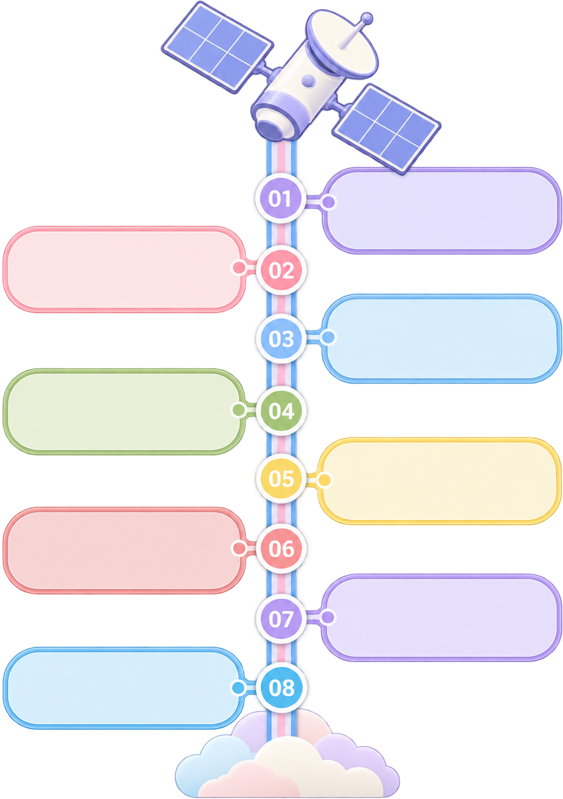
Challenges
How we address them?
Semantic Search
Metadata cannot express concepts like “new structures near river”.
Multi-Temporal Reasoning
Multimodal Retrieval
Semantic Search
Text and image queries need a common representation.
Encoder based embeddings enable semantic search beyond exact keywords.
Two images only describe a pairwise difference.
Multimodal Retrieval
Text and satellite images share one embedding space for unified retrieval.
Sensor & Resolution Handling
Potential Challenges & Risks
Metadata-aware ingestion normalizes data across sensors, bands, and resolutions.
Scaling with Archive Growth
Sensor & Resolution Variability
False-Alarm Suppression
Repeated re-indexing or re-clustering slows down as imagery grows.
Two-tier quality filtering removes clouds, noise, seasonal variation, and spurious changes.
Different sensors have varying bands and spatial resolutions.
Change-Type Classification
Spectral deltas and semantic models classify detected changes into tactical categories.
Offline Processing
Pseudo-Changes (False Alarms)
Local models and data enable secure operation without external network access.
Offline Compliance
Clouds, shadows, haze, seasons, and misregistration can mimic real change.
Archive-Scale Discovery
Pretrained model libraries may attempt network calls even when weights are cached locally.
Vector indexing and clustering support efficient search across growing archives.
Multi-Temporal Reasoning
Multi-date analysis identifies when and where meaningful changes emerge.
Category Mismatch in Change Types
Public benchmark datasets rarely match the project’s exact four categories out of the box.

